Slide 1
Transactional Libraries
Alexander Spiegelman*, Guy Golan-Gueta†, and Idit Keidar†*
*Technion †Yahoo Research

Slide 2


Multi-Threading is Everywhere

Slide 3
Agenda
Motivation
Concurrent Data Structure Libraries (CDSLs) vs Transactional Memory
Introducing: Transactional Data Structure Libraries (TDSL)
Example TDSL algorithm
Skiplist
Composition of multiple objects (skiplists and queues)
Fast abort-free singletons
Library composition
Evaluation

Slide 4
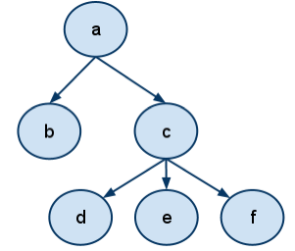
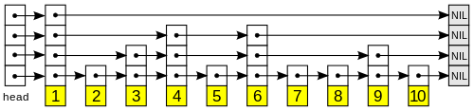
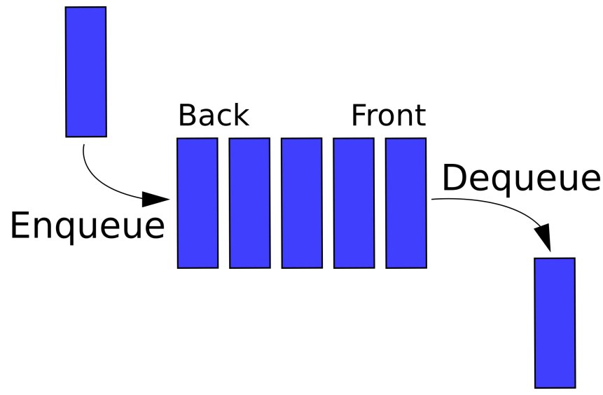
Data Structures (DS)
Essential building blocks in modern SW
Map, skiplist, queue, etc.

Slide 5
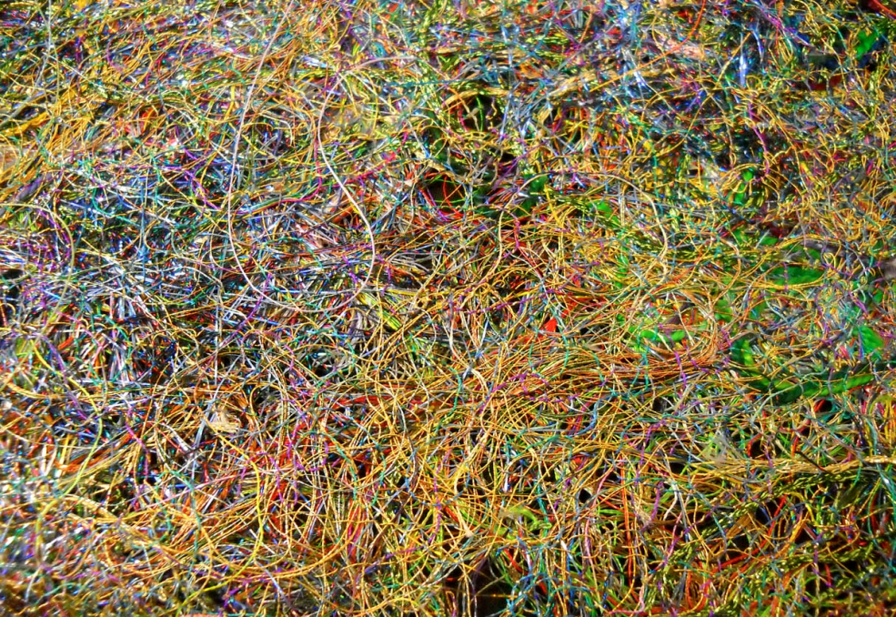

But Are They “Thread Safe”?
Correct under concurrency?
OR
?

Slide 6
“Thread-Safe” Concurrent DS Libraries
Widely used in real life software
Numerous research papers
Concurrent Skipklist [Herlihy, Lev, Luchangco, Shavit: A simple optimistic skiplist algorithm] [Fraser: Practical lock freedom] …
Concurrent queue [Michael, Scott: Simple, fast, and practical nonblocking and blocking concurrent queue algorithms] [Gramoli, Guerraoui: Reusable concurrent data types]
Concurrent binary tree [Bronson, Casper, Chafi, Olukotun: A practical concurrent binary search tree] [Drachsler, Vechev, Yahav: Practical concurrent binary search trees via logical ordering]

Slide 7
Concurrent Data Structure Libraries (CDSLs)
Each operation executes atomically
Custom-tailored implementation preserves semantics
Thread
Thread
Thread
map
queue

Slide 8
Are They Really Thread Safe??
balance ←map.get (key=Yoni)
balance ←map.get(key=Yoni)
newBalance← balance+deposit
newBalance← balance+deposit
map.set(key=Yoni,newBalance)
map.set(key=Yoni,newBalance)
repQ.enq(“Yoni’s balance=new”)
repQ.enq(“Yoni’s balance=new”)
Oops! Atomic operations are not enough

Slide 9
Software Transactional Memory (STM)
TL2, TinySTM, SwissTM,…
Transactions (TXs) = atomic sections including multiple DS operations
Begin_TX balance←map.get(key=Yoni)
newBalance ← balance + deposit
map.set(key=Yoni, newBalance)
repQ.enq(“Yoni’s balance=new”)
End_TX
App
end
map
queue
abort
begin
STM

Slide 10
CDSL vs STM
 | CDSL | STM
Performance | ✓ | ✗
Exploit DS semantics & structures | ✓ | ✗
Used in practice | ✓ | ✗
Generality | ✗ | ✓
Composability | ✗ | ✓

Slide 11
Agenda
Motivation
Concurrent Data Structure Libraries (CDSLs) vs Transactional Memory
Introducing: Transactional Data Structure Libraries (TDSL)
Example TDSL algorithm
Skiplist
Composition of multiple objects (skiplists and queues)
Fast abort-free singletons
Library composition
Evaluation

Slide 12
TDSL: Bringing Transactions into CDSL
App
App
App
STM programmability: TXs span any number of operations
Legacy “singleton” operations: fast, abort-free
end
abort
begin
Custom-tailored, performance of CDSL
Transactional Library
Missing: Generality of STM
map
queue

Slide 13
TDSL Benefit 1: Programmability
Support for legacy code
Fast, abort-free singletons
Power of transactions
Begin_TX val←map.get(key=Yoni)
new← val+deposit
map.set(key=Yoni,new)
repQ.enq(“Yoni’s balance=new”)
End_TX
App
App
App
Transactional Library
map
queue

Slide 14
TDSL Benefit 2: Semantic Optimization
Use known transactional solutions
But, take advantage of semantics & structure of each DS to reduce aborts & overhead
Reduce read-set
Do some of the work non-transactionally

Slide 15
Example of Abort Reduction
Two concurrent put operations
Put(23) traverses the list, reads nodes that put(4) updates
Conflict, STM would abort at least one
But no semantic conflict
23
2
5
9
17
34

Slide 16
Example of Abort Reduction
Two concurrent put operations
Put(23) traverses the list, reads nodes that put(4) updates
Conflict, STM would abort at least one
But no semantic conflict
4
23
2
5
9
17
34

Slide 17
Example of Abort Reduction
Two concurrent put operations
Put(23) traverses the list, reads nodes that put(4) updates
Conflict, STM would abort at least one
But no semantic conflict
4
23
2
5
9
17
34

Slide 18
TDSL Benefit 3: Mix & Match
Maps allow lots of concurrency
Amenable to optimistic synchronization
Queues do not
Pessimistic synchronization better
STM picks one
Our TDSL can mix & match
App
App
App
Transactional Library
optimistic map
pessimistic queue

Slide 19
Agenda
Motivation
Concurrent Data Structure Libraries (CDSLs) vs Transactional Memory
Introducing: Transactional Data Structure Libraries (TDSL)
Example TDSL algorithm
Skiplist
Composition of multiple objects (skiplists and queues)
Fast abort-free singletons
Library composition
Evaluation

Slide 20
Skiplist Roadmap
Add STM-like transaction support to simple linked list
Based on TL2 STM algorithm
Optimization: remove redundant validation and tracking
Reduce aborts
Use semantics and structure
Optimization: shorten transactions
Reduce aborts
Non-transactional index
Lazy GC

Slide 21
Step 1: Standard STM
Take a simple linked list
Add TL2 mechanism to support TXs:
Add a version to each node
Get versions from global version clock (GVC)
Maintain read-set with read versions
Defer updates, track in write-set
To commit: lock write-set, validate read-set, increment GVC, update
2
5
9
17
34

Slide 22
Step 1: Standard STM
insert(10):
read-set
write-set
10
2
5
9
9
10
17
Local memory
Read
Shared memory
Validate
GVC
2
5
9
17
34

Slide 23
Step 2: Reduce Read-Set
Exploit structure and semantics
insert(10):
read-set
write-set
10
9
9
10
Local memory
Read
Shared memory
Validate
GVC
2
5
9
17
34

Slide 24

Step 3: Non-Transactional Index
Imagine we could guess the right node
So, we could be faster and save aborts during the traversal
GVC
2
5
9
17
34

Slide 25
Step 3: Non-Transactional Index
getSmaller
Returns some node with a smaller key
For performance, not much smaller
Implemented as (concurrent) skiplist
For example
App
add(n)
remove(n)
getSmaller (key)
Index

Slide 26
Step 3: Non-Transactional Index
insert(10):
App
10
getSmaller(10)
return 5
Start traverse from 5
Index
GVC
2
5
9
17
34

Slide 27
Step 3: Non-Transactional Index
Updated outside the TX (if completes successfully)
Reduces aborts, overhead
But:
May return nodes with smaller keys than predecessor
⇒ longer traversals
May return removed nodes
Subtle, more details in the paper

Slide 28
Agenda
Motivation
Concurrent Data Structure Libraries (CDSLs) vs Transactional Memory
Introducing: Transactional Data Structure Libraries (TDSL)
Example TDSL algorithm
Skiplist
Composition of multiple objects (skiplists and queues)
Fast abort-free singletons
Library composition
Evaluation

Slide 29
Composition
One GVC shared among all objects
Commit:
Lock all write sets
Validate all read sets
Increase GVC
Update objects and release locks

Slide 30
Agenda
Motivation
Concurrent Data Structure Libraries (CDSLs) vs Transactional Memory
Introducing: Transactional Data Structure Libraries (TDSL)
Example TDSL algorithm
Skiplist
Composition of multiple objects (skiplists and queues)
Fast abort-free singletons
Library composition
Evaluation

Slide 31
Fast Abort-Free Singletons
Use the index
Do not increment GVC
No contention
As fast as in CDSL
Make transactions aware of singletons using designated fields
Details in the paper

Slide 32
Agenda
Motivation
Concurrent Data Structure Libraries (CDSLs) vs Transactional Memory
Introducing: Transactional Data Structure Libraries (TDSL)
Example TDSL algorithm
Skiplist
Composition of multiple objects (skiplists and queues)
Fast abort-free singletons
Library composition
Evaluation

Slide 33
Compose With Existing Libraries
Modify library to support certain API
E.g., TL2 STM naturally supports it
E.g., use standard 2 phase locking
Together we get general transactions
Ones supported fully by a custom-tailored TDSL are fast
Others less so

Slide 34
Agenda
Motivation
Concurrent Data Structure Libraries (CDSLs) vs Transactional Memory
Introducing: Transactional Data Structure Libraries (TDSL)
Example TDSL algorithm
Skiplist
Composition of multiple objects (skiplists and queues)
Fast abort-free singletons
Library composition
Evaluation

Slide 35


Singletons
As good as baseline
our skiplist rotating nohotspot fraser optimistic baseline
Do not support transactions

Slide 36
Transactions
We have less overhead
We have less aborts
our skiplist SeqTL2 FriendlyTL2

Slide 37
Intruder
Testing multiple skiplists and queues in a real application
cannot support intruder
our skiplist SeqTL2 FriendlyTL2

Slide 38
Related Work
Boosting and optimistic boosting
[M. Herlihy and E. Koskinen: Transactional boosting: methodology for highly-concurrent transactional objects]
[Ahmed Hassan, Roberto Palmieri, Sebastiano Peluso, and Binoy Ravindran: Optimistic Transactional Boosting]
Open nesting
[Y. Ni, V. S. Menon, A.-R. Adl-Tabatabai, A. L. Hosking, R. L. Hudson, J. E. B. Moss, B. Saha, and T. Shpeisman. Open nesting in software transactional memory]
Reagents
[A. Turon. Reagents: expressing and composing fine-grained concurrency]

Slide 39

Conclusion
 | CDSL | STM | TDSL
Performance | ✓ | ✗ | ✓
Exploit DS semantics | ✓ | ✗ | ✓
Used in practice | ✓ | ✗
Generality | ✗ | ✓ | ✓
Composability | ✗ | ✓ | ✓
We hope that the community will adopt this concept
Build and use more such libraries

